Slide 1
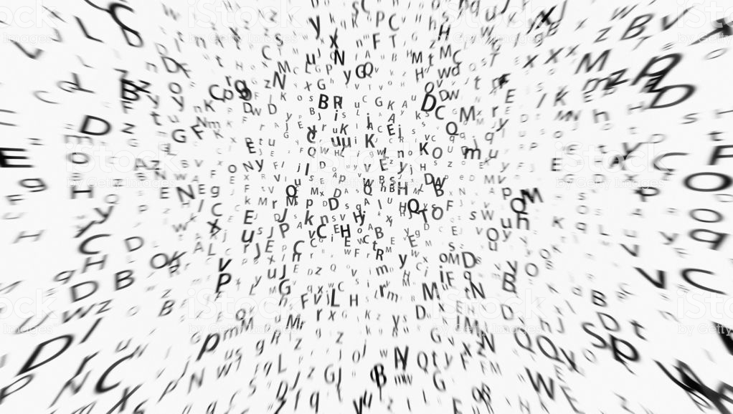
Lexicon based analysis of topic related word usage
Anke Unger
TDT4310

Slide 2
Overview
WHY is the analysis interesting?
HOW is it build?
WHAT are the results?
WHERE are the fallbackpoints?
WHAT can we take away?

Slide 3
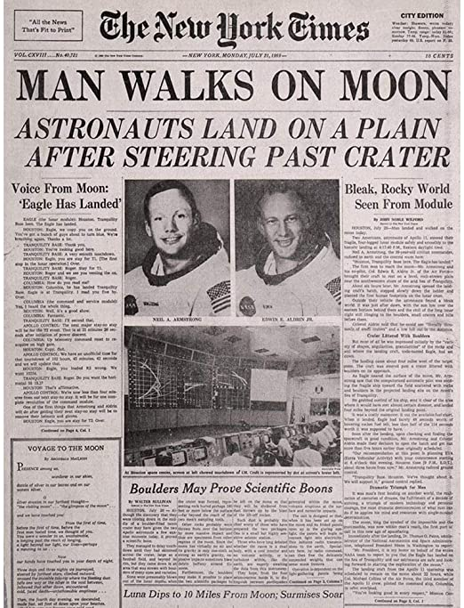
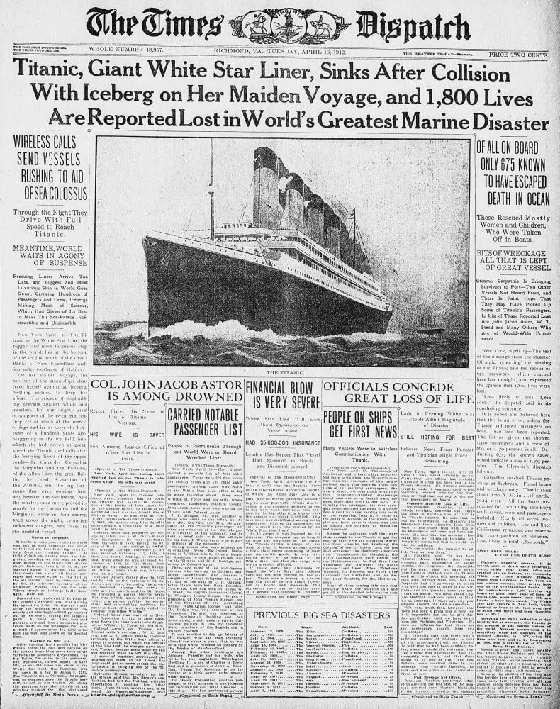
How are certain topics depicted in the media?
Source: https://www.chroniclelive.co.uk/news/north-east-news/how-sunday-sun-first-newspaper-16561422
Source: https://www.ultimatetitanic.com/titanic-news/?category=Sinking

Slide 4
Supervised VS Semi-Supervised training
Language is flexible
Most tagged sets for short texts → Narrow applicability
Idea:
Lexicon based for biased or offensive language lexica
Semi-Supervised for sentiment lexicon → Test on articles regarding LGBT-community and Corona Crisis

Slide 5
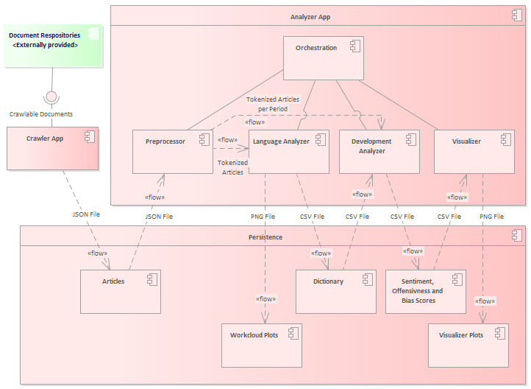

Slide 7
Crawling and Preprocessing
[covid, cov, corona, sars, outbreak, pandemic, virus]
[…, the, war, of, words, between, the, trump, administration, and, china, over, the, origin, of, coronavirus, has, escalated, as, president, trump, is, going, out, of, his, way, to, call, it, the, chinese, virus, and, china, has, embarked, on, a, propaganda, campaign, to, shift, blame, for, the, pandemic, away, from, the, chinese, communist, party, handling, of, the, crisis, …]
from https://www.foxnews.com/politics/gloves-off-over-coronavirus-trump-administration-china-escalate-clash-over-origins

Slide 8
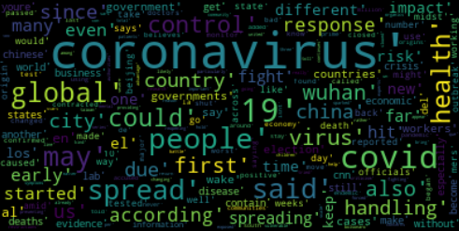
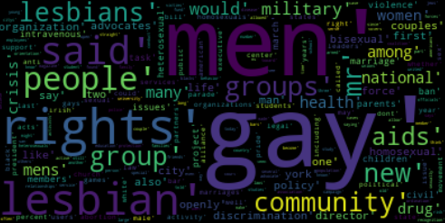
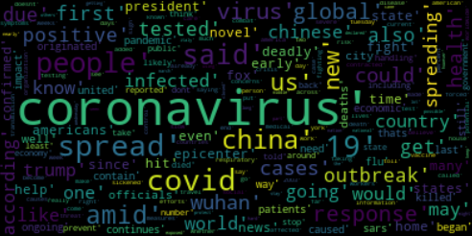
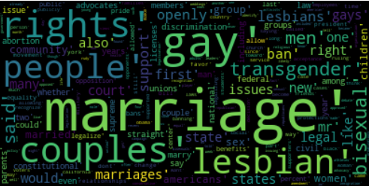
Wordclouds Corona Crisis and LGBT
Corona-context CNN
LGBT related articles 1986-1999
Corona-context Fox News
LGBT related articles 2000-2015

Slide 9
Sentimentlexicon extension
Conjunctions identified
‘but’ → opposite polarity
‘and’ → same polarity
Weighted with Inverse Document Frequency (IDF)
Result:
’economic’, ’responsible’, ’stable’, ’angerthe, ’heat-sensitive’

Slide 10
Analyse data for different time steps
Scores for biased, offensive, positive or negative wording

Slide 11
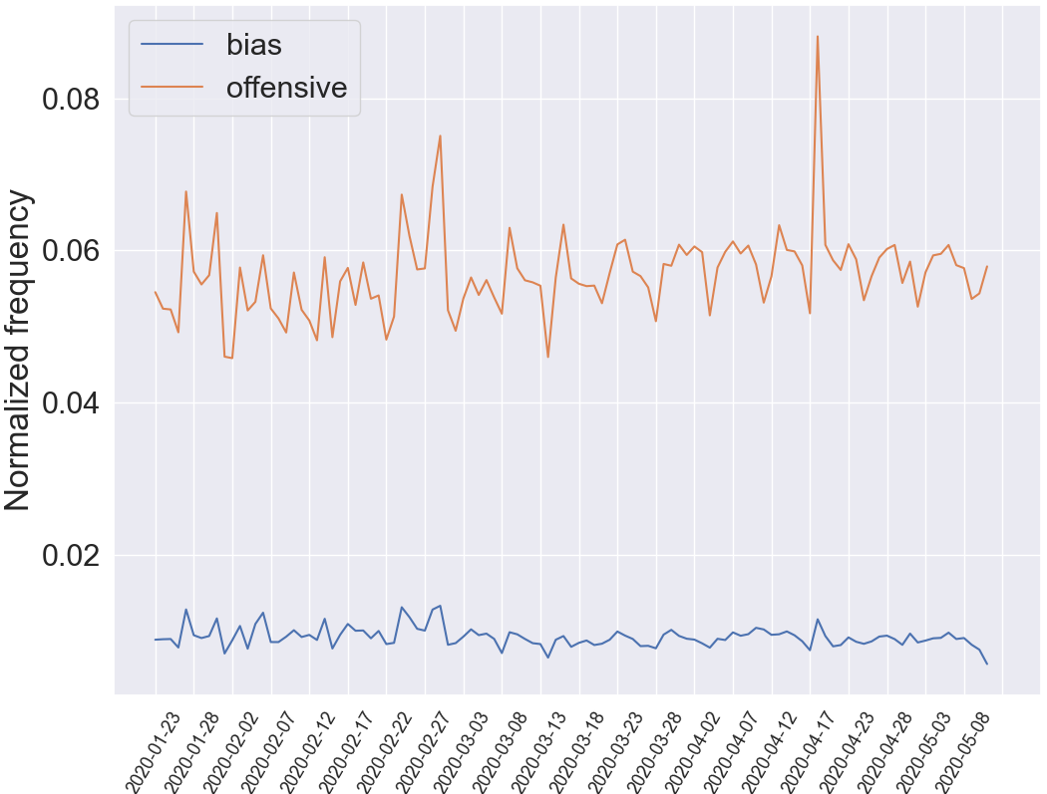
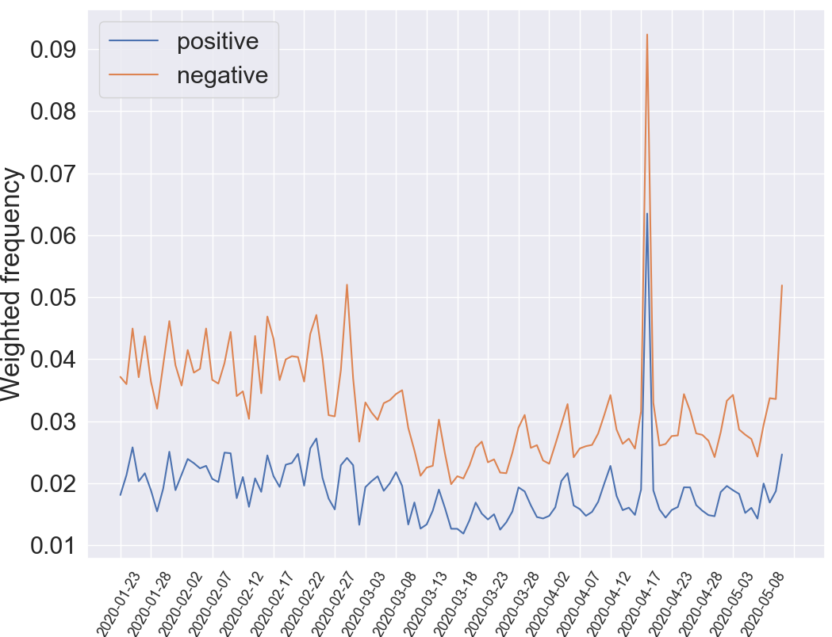
Development over time

Slide 12
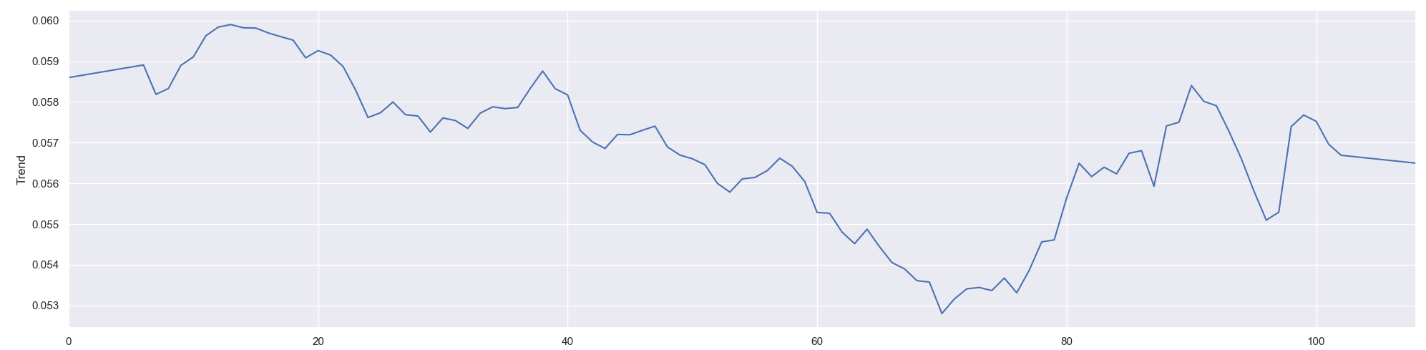
Trend?
Trend in usage of possibly offensive language

Slide 13

Take home
Lexicon based approaches demand less previous knowledge
Frequency of word usage helps to determine overall topics of articles
Frequency of word usage helps to give suggestions how controversial a topic is
https://www.shutterstock.com/de/search/take-home

